Slide 1
DEMO,
Boring template #1
The Third
Adam
Pisky-Nagy

Slide 2

let learnt: poorJokes =
CSS is self-aware
EJS doesn’t like my ideas
…but I do them anyway
Alien TS types in DOM
stuff
Notes:
- For every selector there’s another type

Slide 3
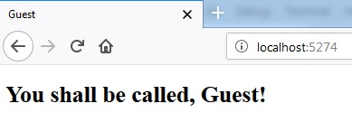
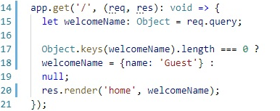
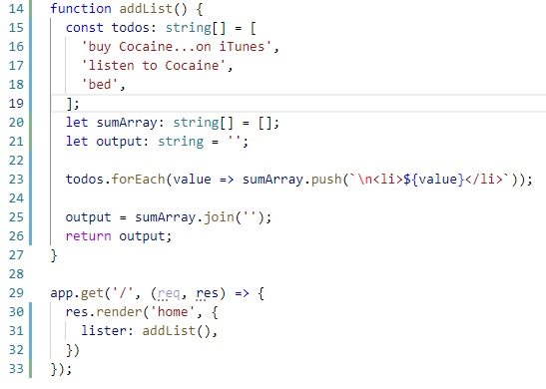
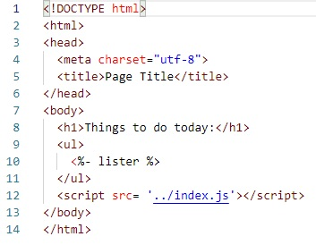
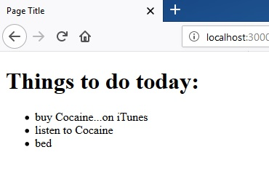
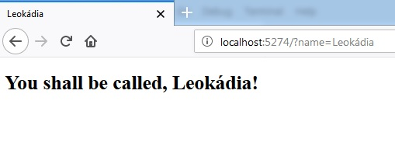
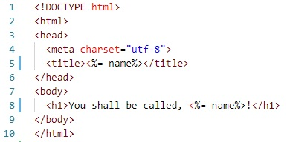

let learnt: codeList =
Set default query string in EJS
Empty Object !== empty Object
Writing HTML with EJS
…using functions

Slide 4

let learnt: moral =
Failure is great…in a way
Nothing else

Slide 5


Thanks for the attention!
…or pretending it.
Find me @ GitHub @ Adamman48
or IWIW
or LinkdeIn
or Facebook
Notes:
Crown jewel random map generator

